Slide 1

Airplane Safety
Is the media correct and if not, what should we do about it?

Slide 2
Objective
Where are we now?
Where will we be?
What should we do about it?

Slide 3
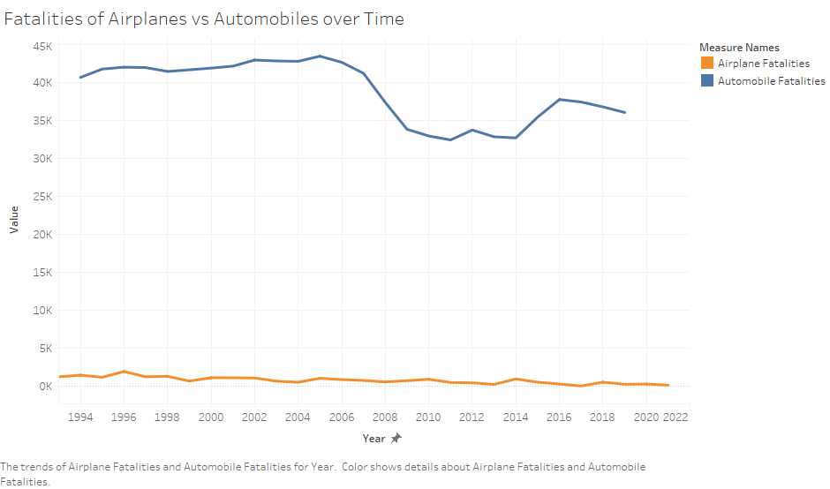
Where are we now?
The media is saying that air travel is no longer safe: that is simply not true.
Air travel is much safer than automobiles and has remained that way since the dawn of both technologies.
While both methods continue to get safer, air travel is still safer than other methods of travel by a large gap.
Note: Only auto data from 1994 and later was available for this study.
Sources: https://aviation-safety.net/
https://www-fars.nhtsa.dot.gov/States/StatesCrashesAndAllVictims.aspx

Slide 4

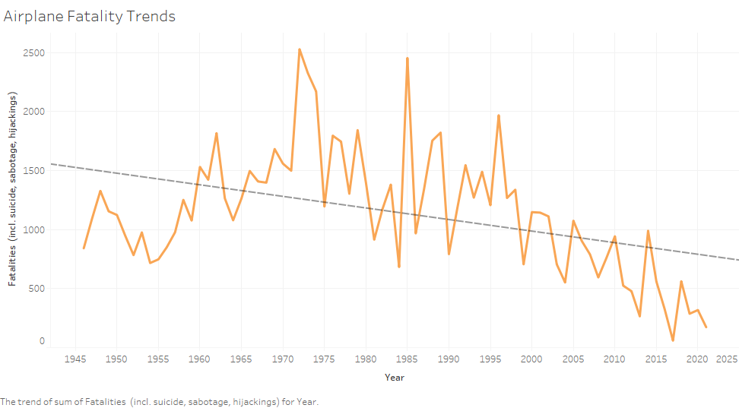
Where are we now?
While airplane fatalities are more sporadic than automobiles, there is a general downward slope overall.
Airplane fatalities are as safe as they’ve ever been!

Slide 5
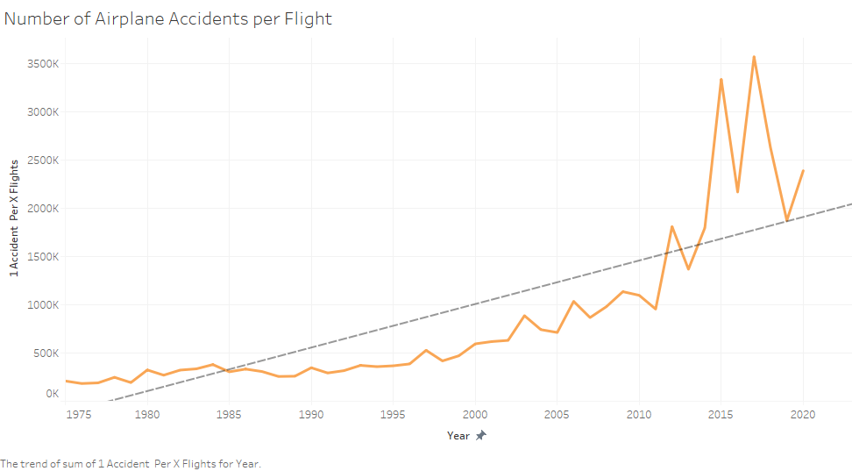
Where are we now?
Not only fatalities are decreasing, so is airplane accidents.
This graph shows for every one accident there are many more flights than there were before.
The rate of having an accident is in fact decreasing.
Notice how accidents are becoming somewhat more sporadic however: this could be something to work on.

Slide 6
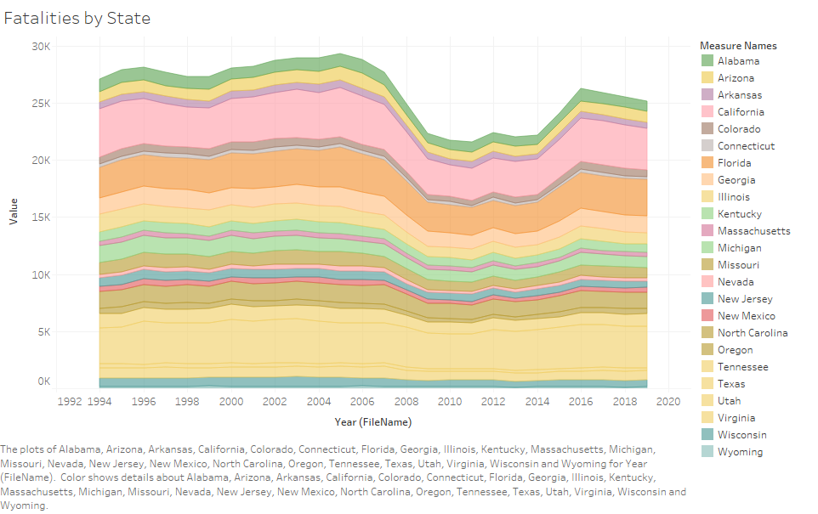
Where are we now?
Automobile fatalities are also on the decline, but at a much slower rate.
The number of fatalities varies by state and population, with Texas, California, and Florida being the highest contenders.
There was a dip in early 2000’s but have risen again.
Note: Some of the states with lower fatalities have been removed from this graph for visibility.

Slide 7
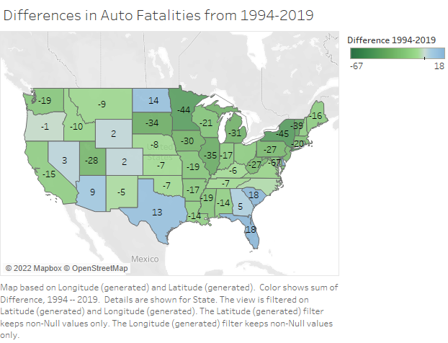
Where are we now?
Here we can see the differences in fatalities by state from 1994 to 2019.
Most states have decreased (green states), but some have increased (blue states).
For example: Florida, Texas, South Carolina, and North Dakota have increased their auto fatalities.

Slide 8
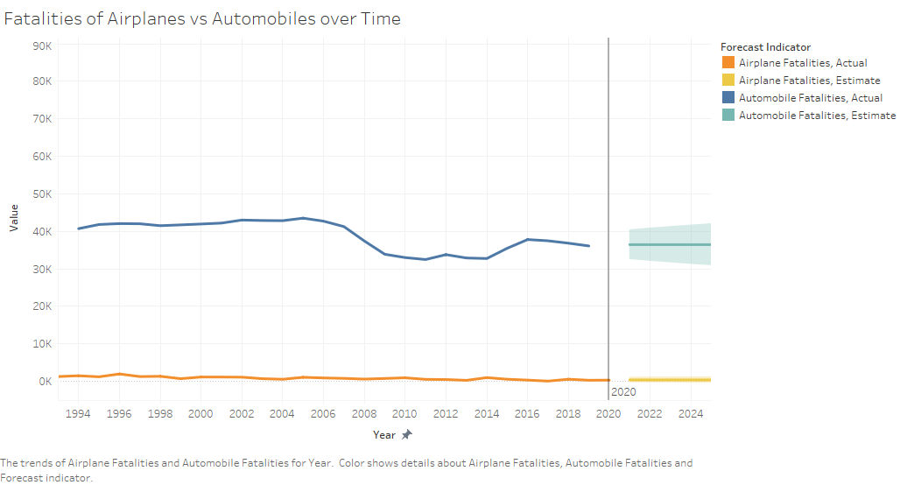
Where will we be?
Most forecasts are showing that the rates will not change from where they are now in the next 15 years.
This is the same as the first graph, but with predictions.

Slide 9
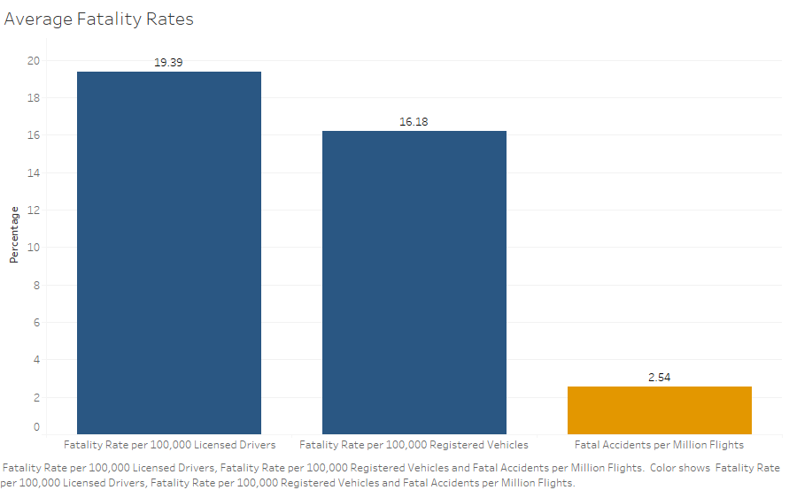
What should we do about it?
We need to change the narrative.
Show the media that the stats are incorrect, and that fatality rates are much lower for airplanes vs automobiles.
This bar graph shows fatality rates per 100,000 drivers and vehicles vs 1 million flights, and the results are still significantly lower.

Slide 10
Conclusion
Airplane accidents and fatalities are on the decline and are much lower in numbers than automobile incidents.
Although airplane fatalities are more sporadic than auto rates, overall they are much safer, where auto rates are on the incline in some areas.
Auto fatalities vary depending on which state you are in, so perhaps the media is pulling false information from the “better performing” states to sway the narrative.
We need to change the narrative to show the facts: that air travel is safe and continues to get safer.
Areas to improve are how random and sporadic airline fatalities and accidents are. If we can pinpoint what is causing them and prevent them from happening, we can potentially make them even safer.
This is a great thing to show the media/shareholders that action is being taken regardless of the false information!

